Slide 1
Machine Learning
Lecture 15a: Neural Network / Deep Learning Basics
Dr. Beilun Wang
Southeast University
School of Computer Science
and Engineering

Slide 2
Today
Neurons
Neural networks
Loss Functions
Backpropagation
Nonlinearity Functions
Neural Nets in Practice

Slide 3
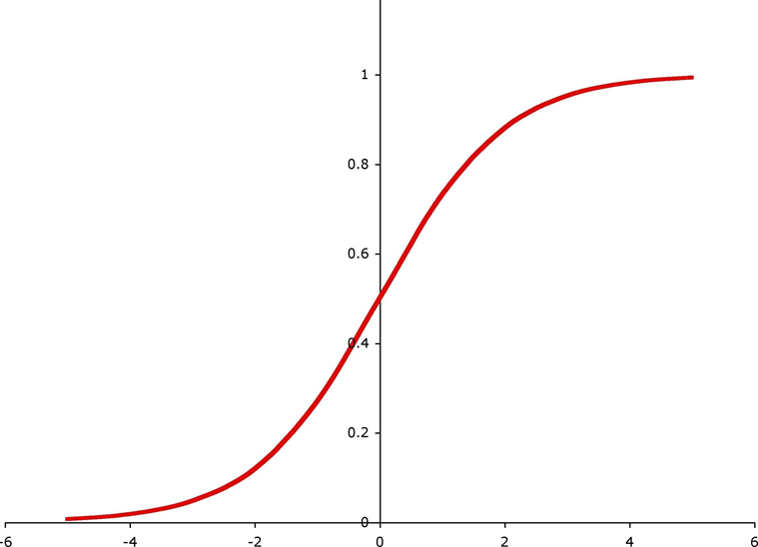
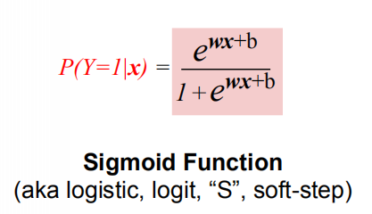
Review: Logistic Regression

Slide 4
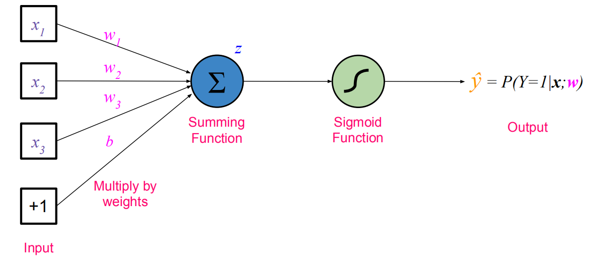
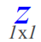
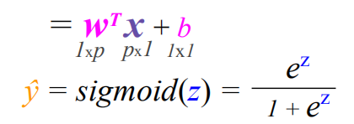

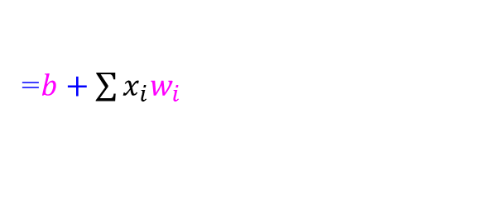
Review: Logistic Regression
=$b+\sum{x_{i}w_{i}}$

Slide 5
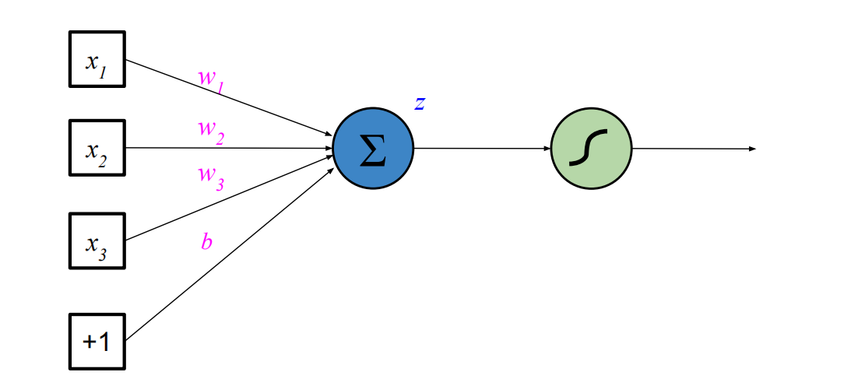
“Neuron” or “Perceptron”

Slide 6
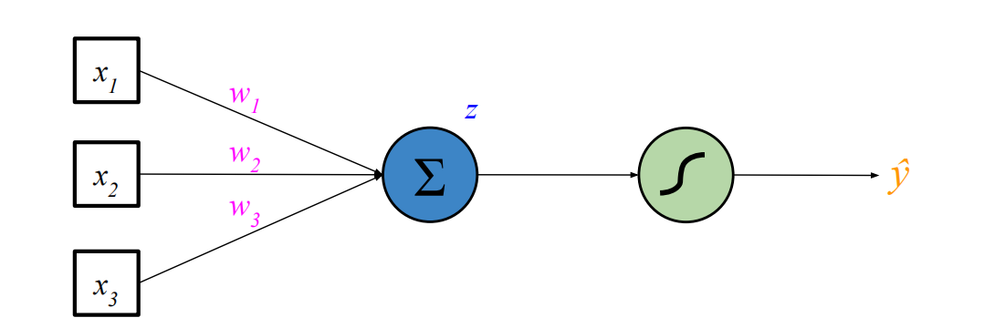
“Neuron” or “Perceptron”
From here on, we leave out bias for simplicity

Slide 7
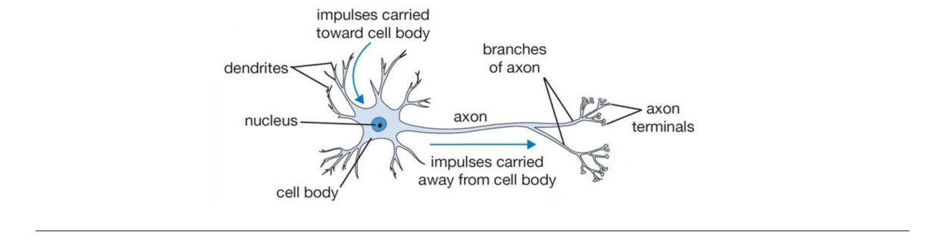
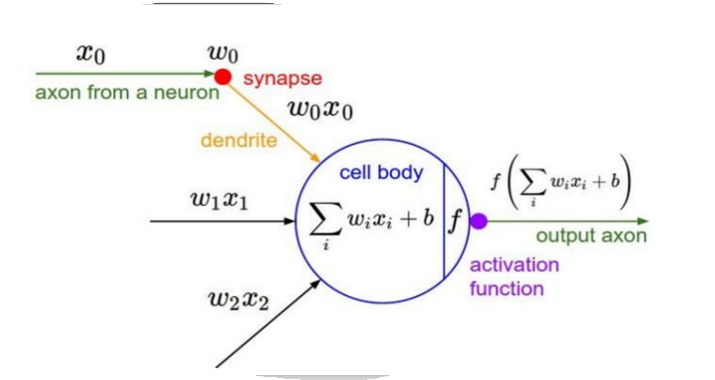
Neurons
http://cs231n.stanford.edu/slides/winter1516_lecture5.pdf

Slide 8
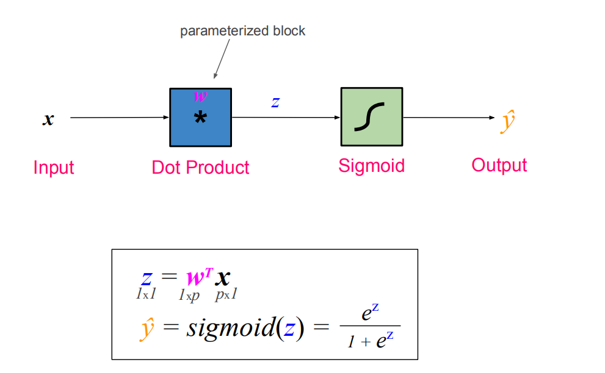
“Block View” of a Neuron

Slide 9
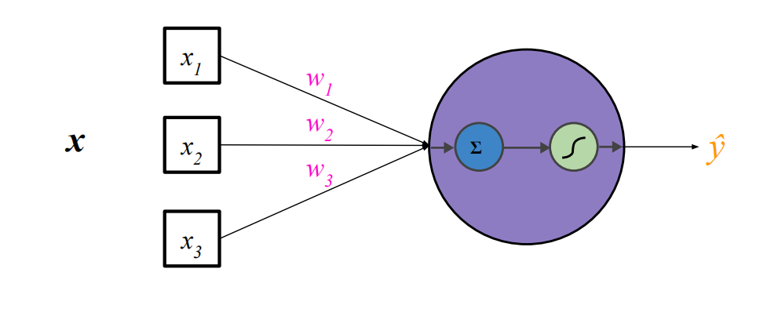
Neuron Representation
The linear transformation and nonlinearity together is typically considered a single neuron

Slide 10
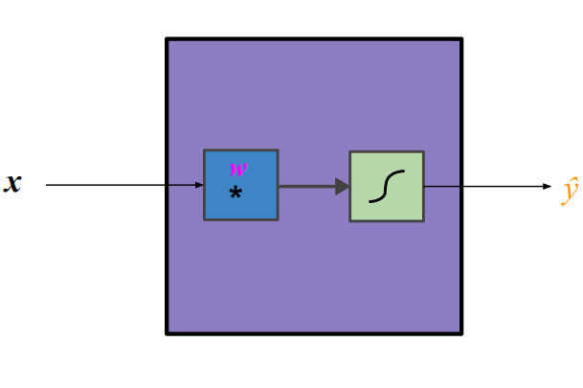
Neuron Representation

Slide 11
Today
Neurons
Neural networks
Loss Functions
Backpropagation
Nonlinearity Functions
Neural Nets in Practice

Slide 12
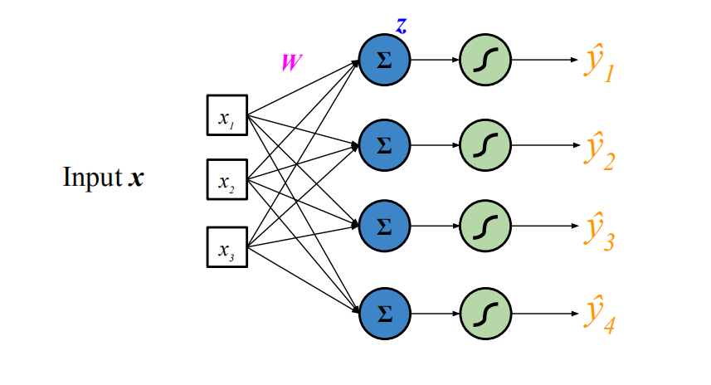
Multiple Neurons

Slide 13
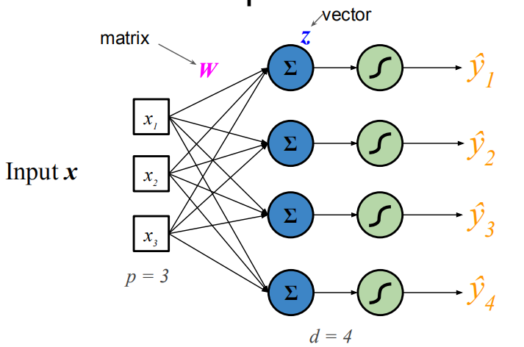
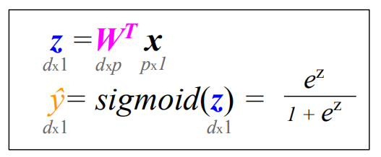
Multiple Neurons

Slide 14
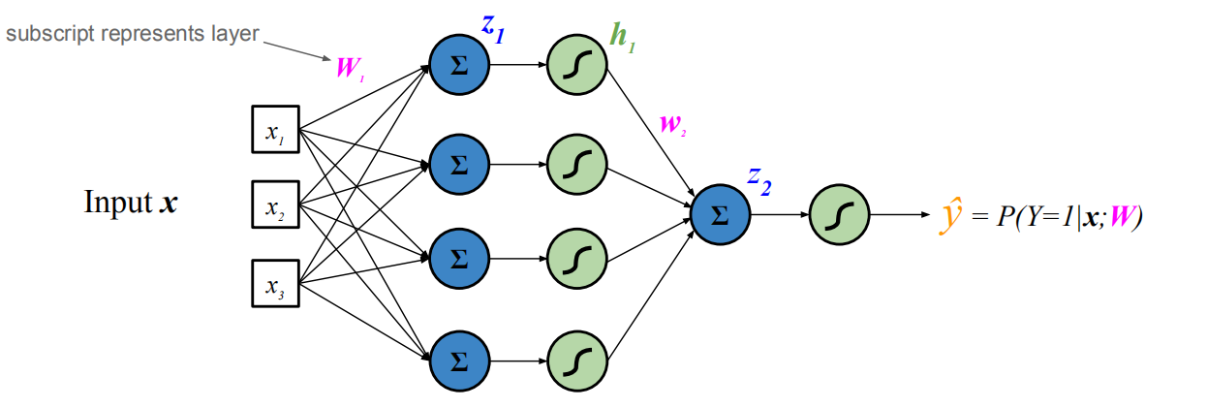
Neural Network (1 Hidden Layer)

Slide 15
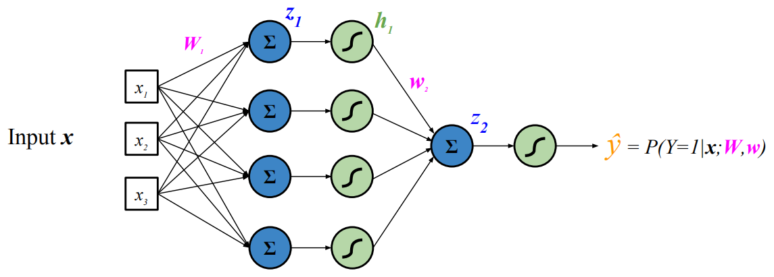
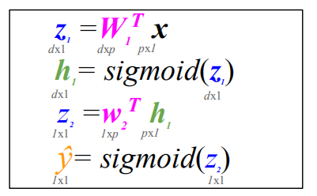
Neural Network (1 Hidden Layer)

Slide 16
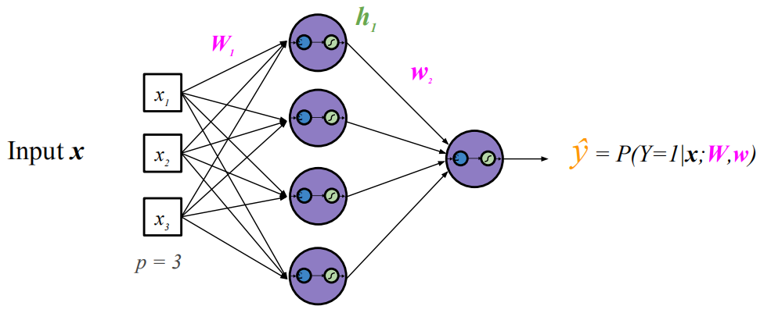
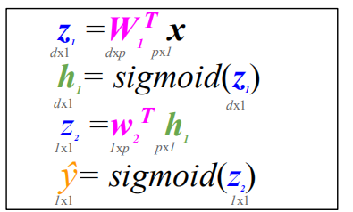
Neural Network (1 Hidden Layer)

Slide 17
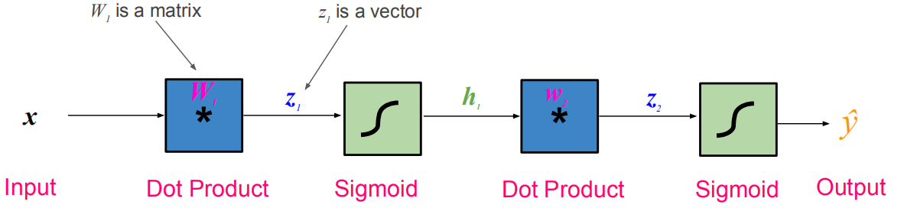

Neural Network (1 Hidden Layer)

Slide 18
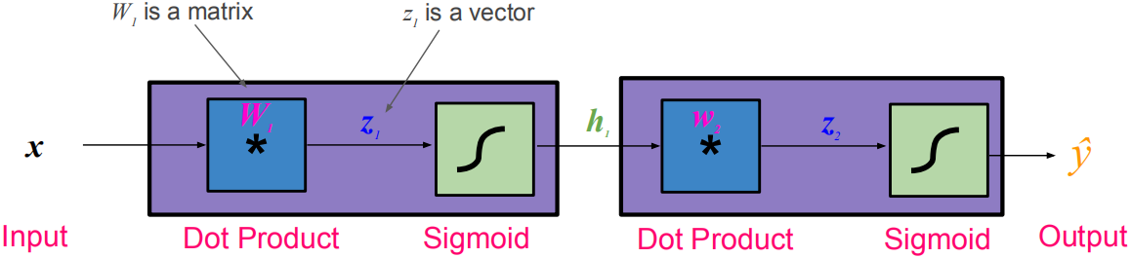
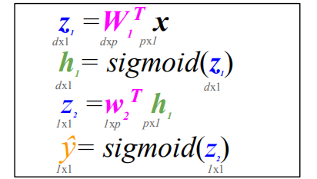
Neural Network (1 Hidden Layer)

Slide 19
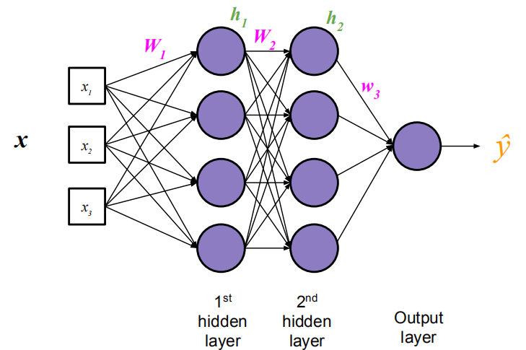
Neural Network (2 Hidden Layers)

Slide 20
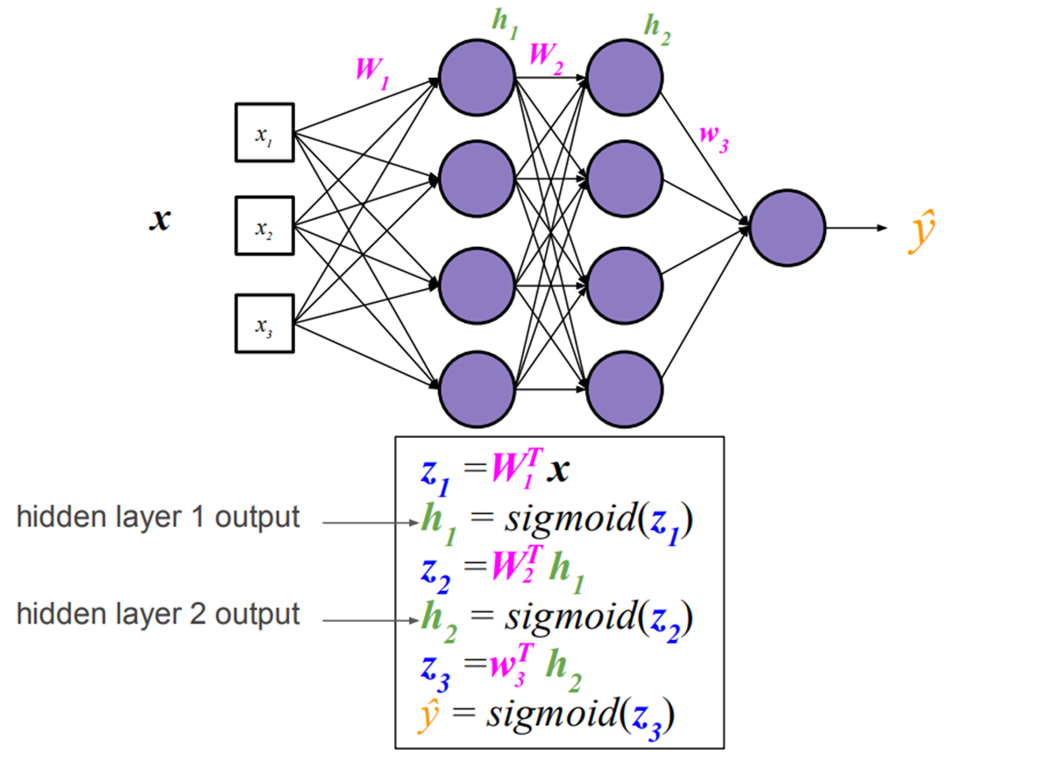
Neural Network (2 Hidden Layers)

Slide 21
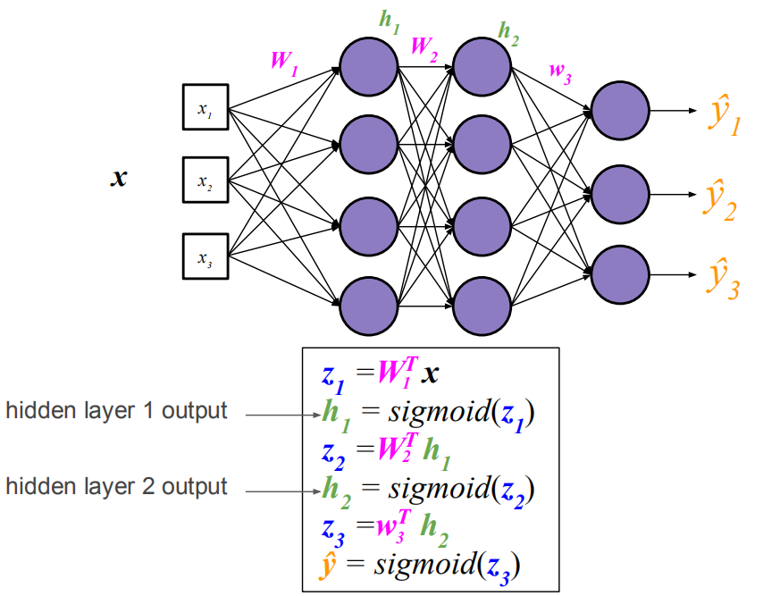
Multi-Class Neural Network (2 Hidden Layers)

Slide 22
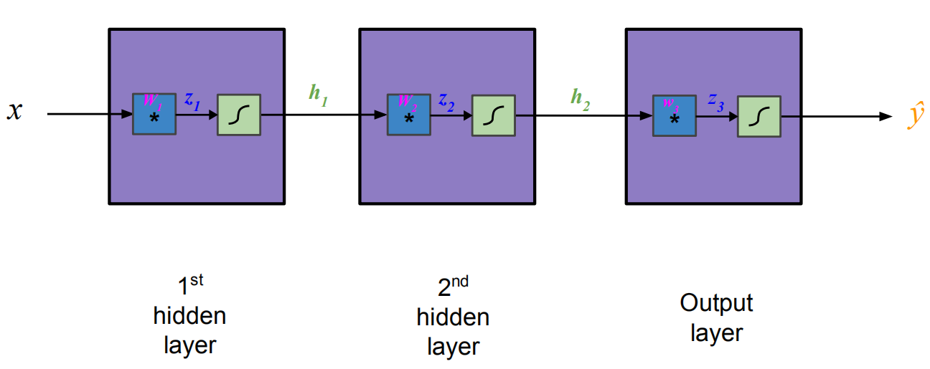
“Block View” Of Multi-Layer Neural Network

Slide 23
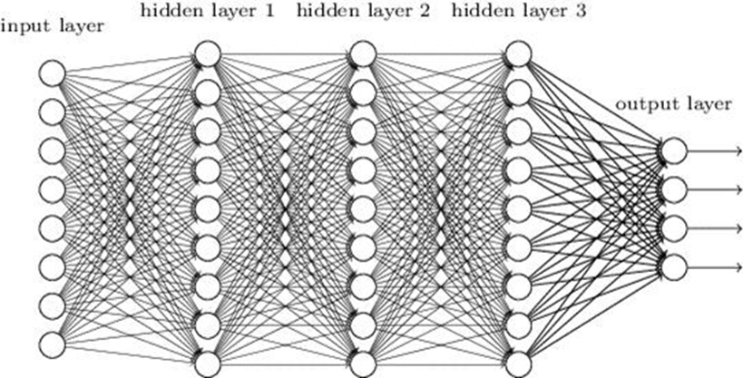
“Deep” Neural Networks (i.e. > 1 hidden layer)

Slide 24
Today
Neurons
Neural networks
Loss Functions
Backpropagation
Nonlinearity Functions
Neural Nets in Practice

Slide 25
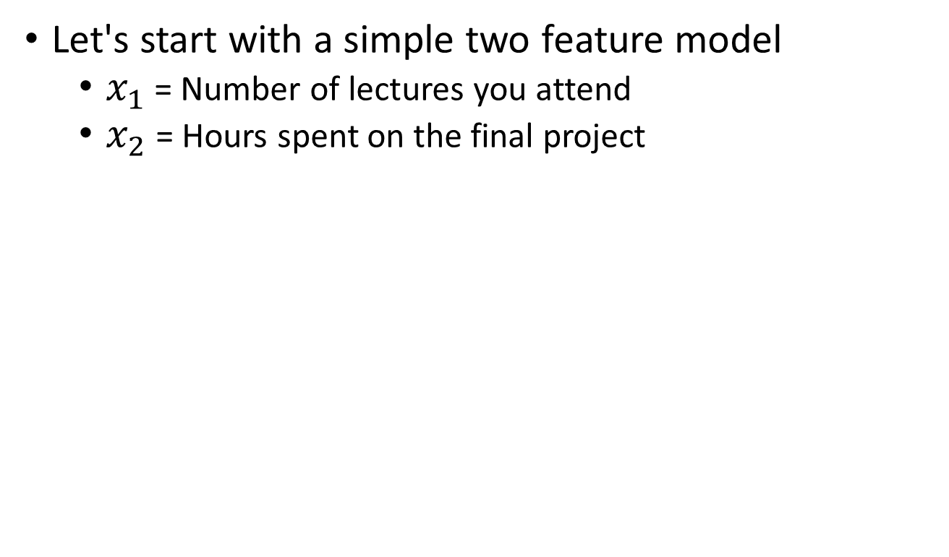
Toy Example: Will I pass this class?
Let's start with a simple two feature model
$x_{1}$ = Number of lectures you attend
$x_{2}$ = Hours spent on the final project

Slide 26
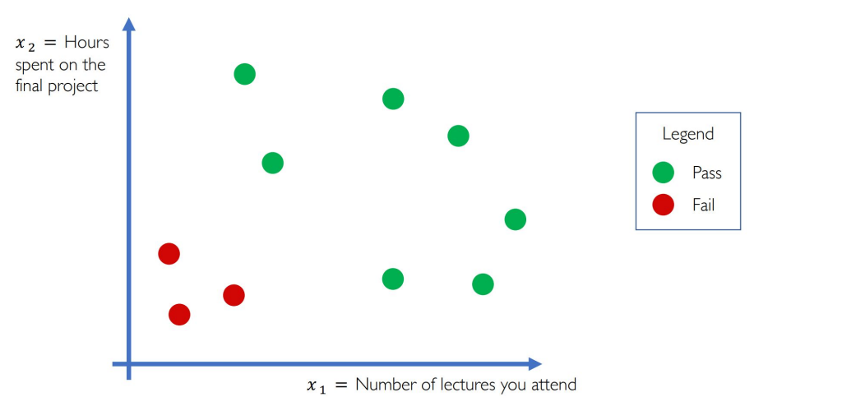
Toy Example: Will I pass this class?

Slide 27
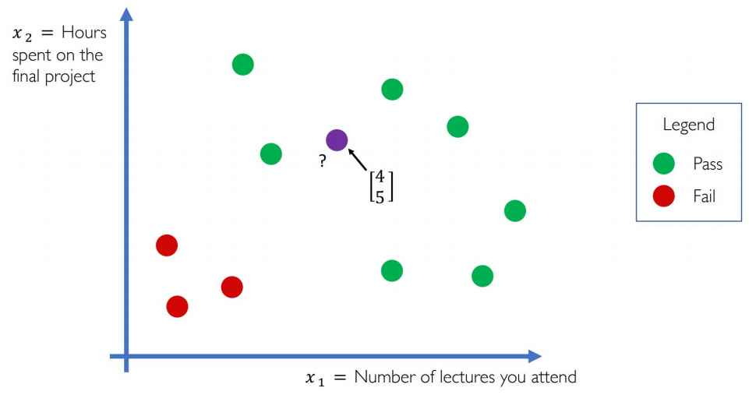
Toy Example: Will I pass this class?

Slide 28
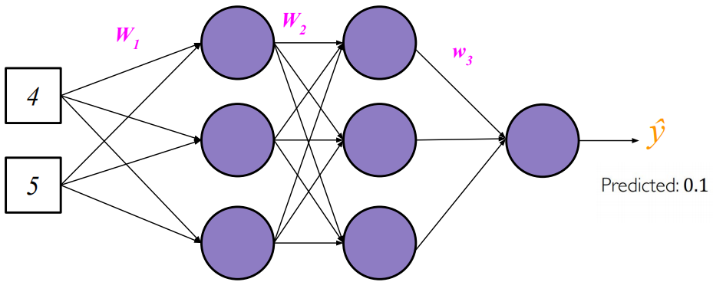
Toy Example: Will I pass this class?

Slide 29
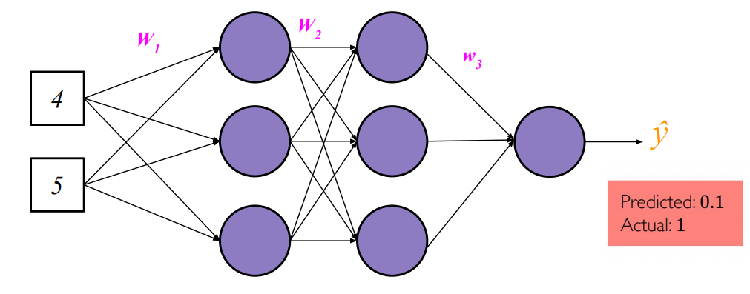
Toy Example: Will I pass this class?

Slide 30
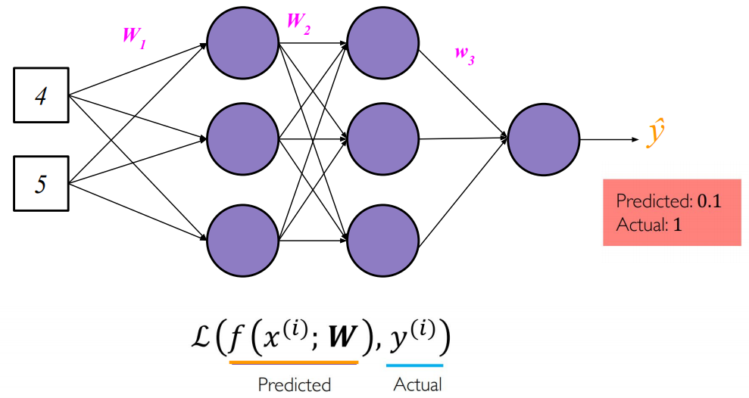
Toy Example: Will I pass this class?
The loss of our network measures the cost incurred from incorrect predictions

Slide 31
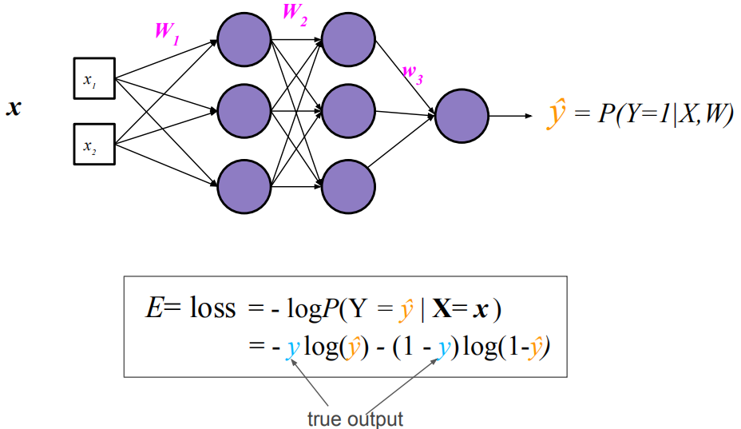
Binary Classification Loss
Binary Cross Entropy Loss

Slide 32
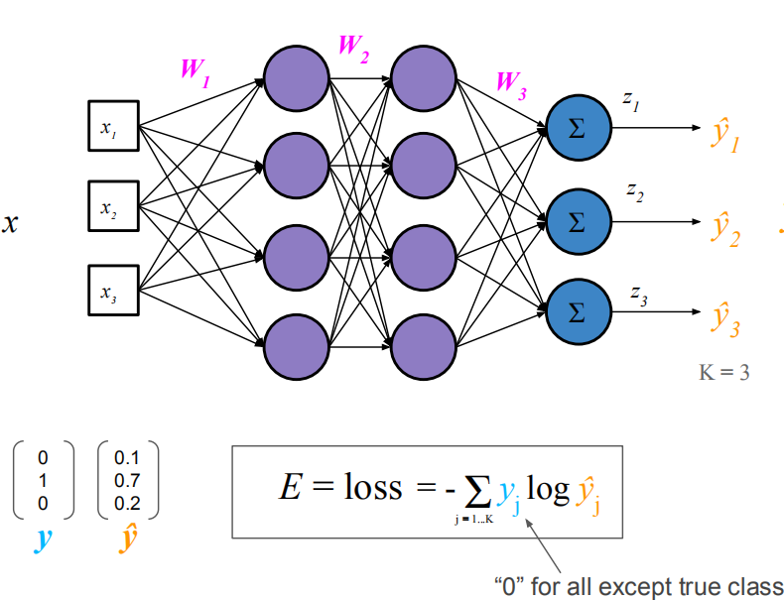
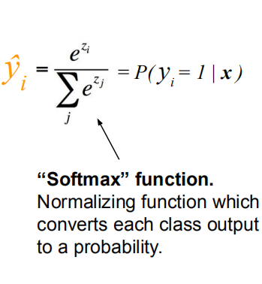
Multi-Class Classification Loss
Cross Entropy Loss

Slide 33
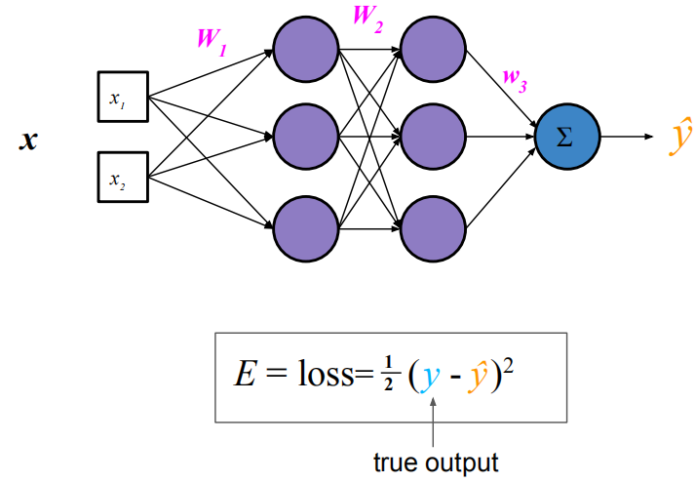
Regression Loss
Mean Squared Error Loss

Slide 34
Today
Neurons
Neural networks
Loss Functions
Backpropagation
Nonlinearity Functions
Neural Nets in Practice

Slide 35
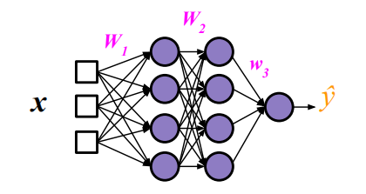
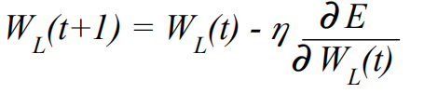
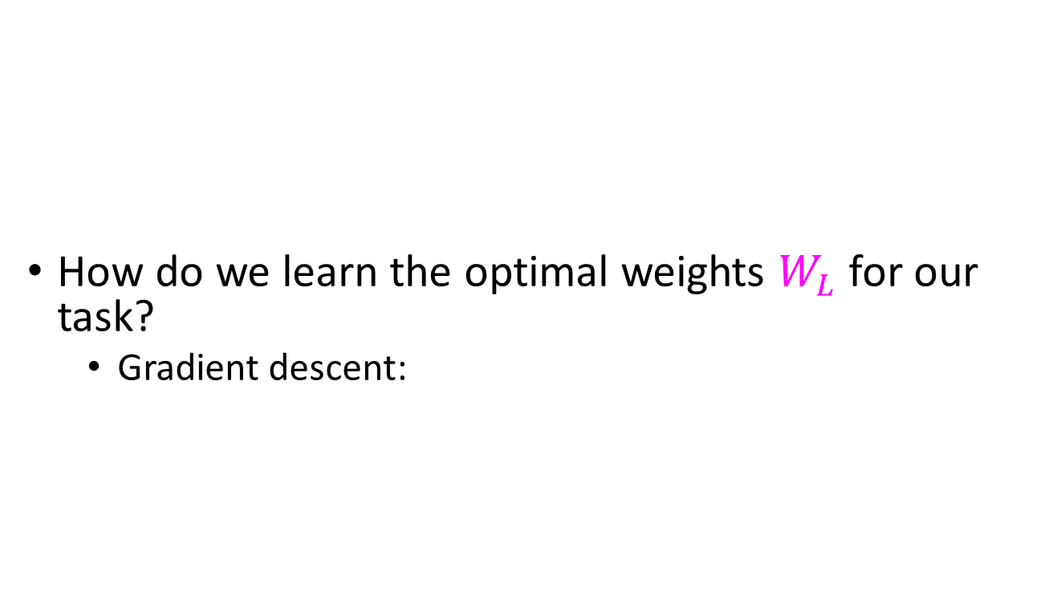
Training Neural Networks
How do we learn the optimal weights $W_{L}$ for our task?
Gradient descent:

Slide 36
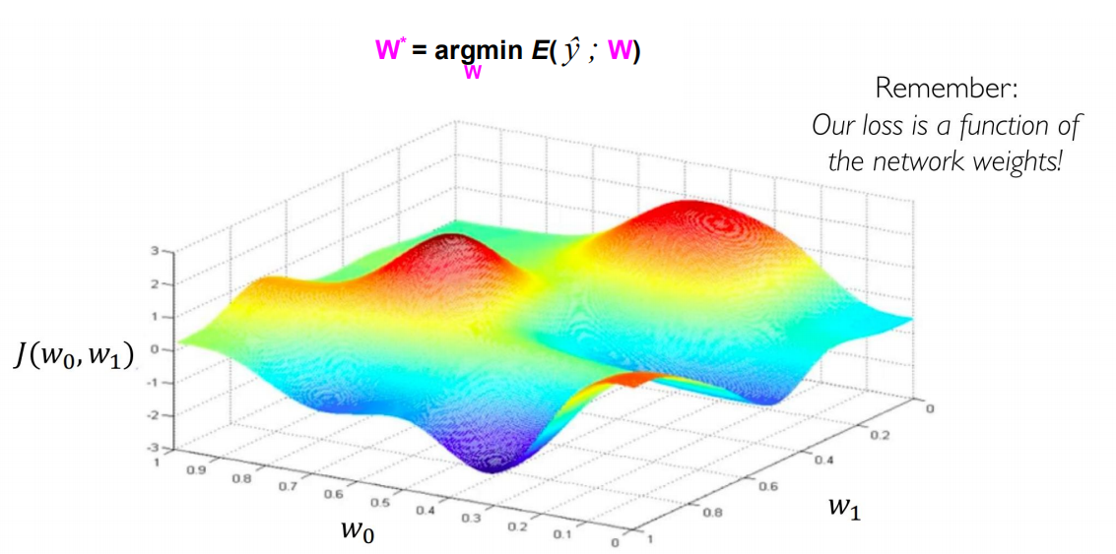
Gradient Descent

Slide 37
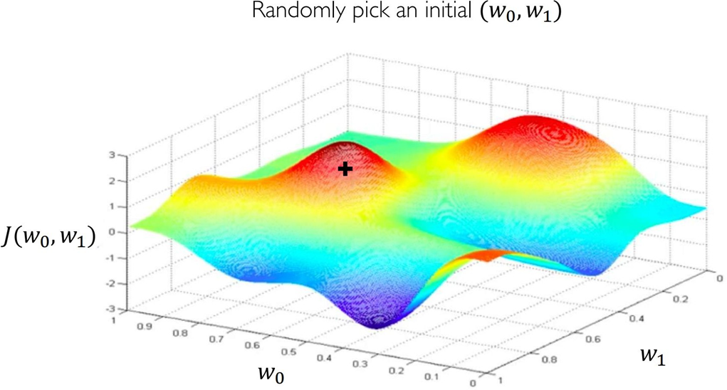
Gradient Descent

Slide 38
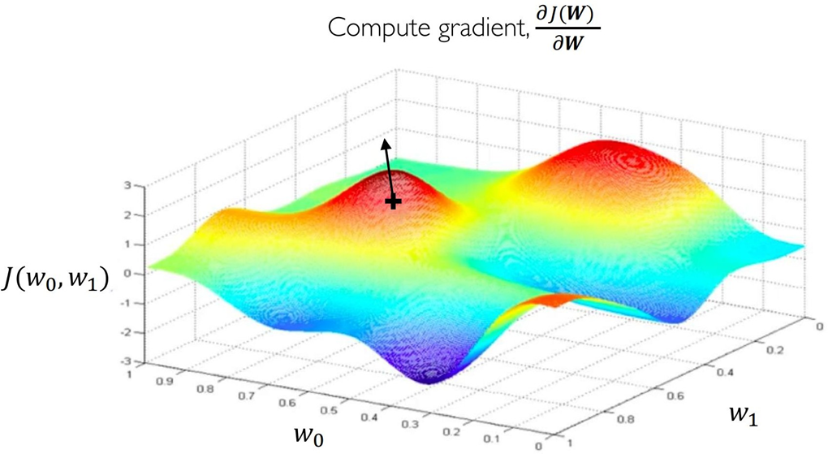
Gradient Descent

Slide 39
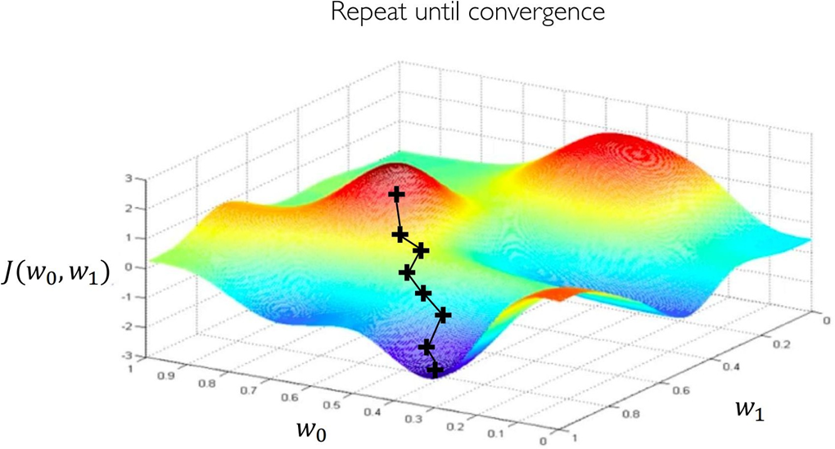
Gradient Descent

Slide 40
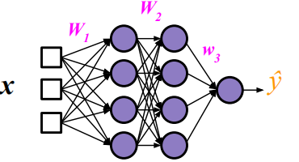
Training Neural Networks
But how do we get gradients of lower layers (e.g. W₁) ?
Backpropagation!
Repeated application of chain rule of calculus
Locally minimize the objective
Requires all “blocks” of the network to be differentiable

Slide 41
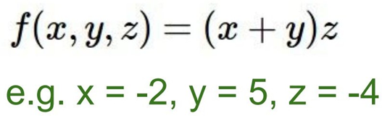
Backpropagation Intro

Slide 42
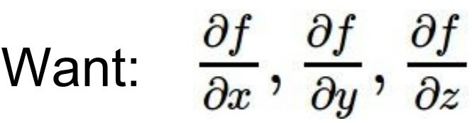
Backpropagation Intro

Slide 43
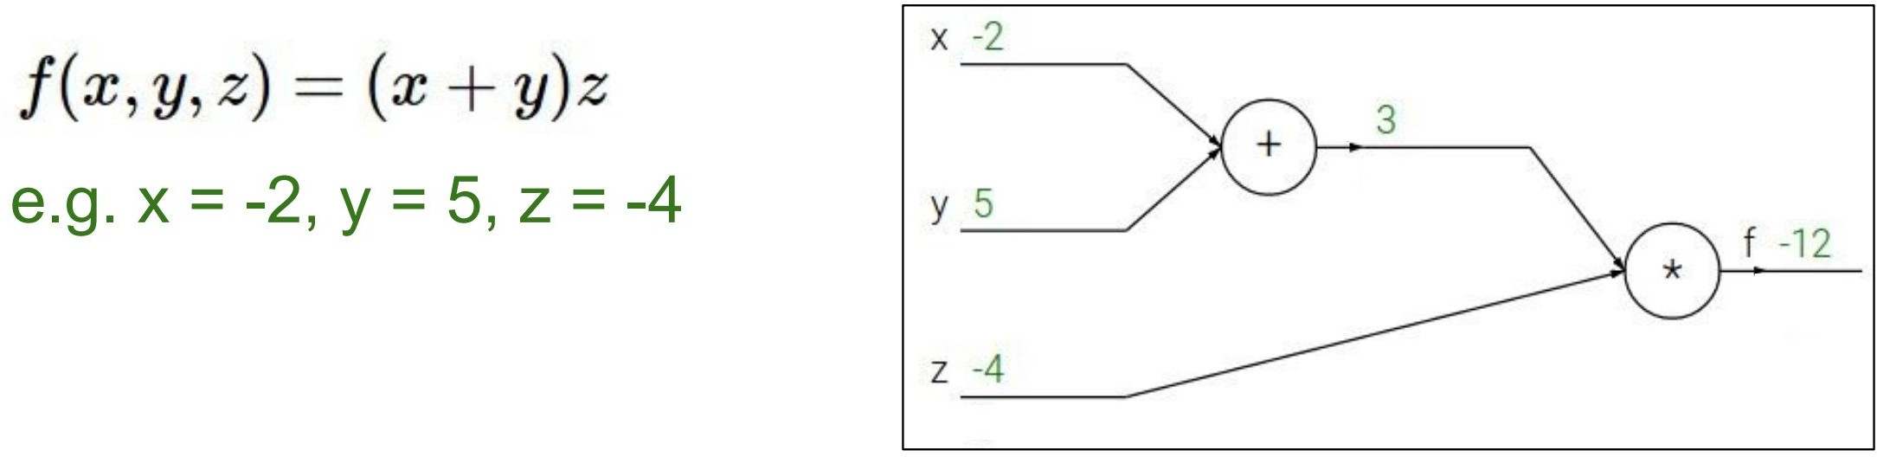
Backpropagation Intro

Slide 44

Backpropagation Intro

Slide 45

Backpropagation Intro

Slide 46

Backpropagation Intro

Slide 47

Backpropagation Intro

Slide 48

Backpropagation Intro

Slide 49

Backpropagation Intro

Slide 50

Backpropagation Intro

Slide 51

Backpropagation Intro

Slide 52

Backpropagation Intro

Slide 53

Backpropagation Intro

Slide 54

Backpropagation Intro

Slide 55

Backpropagation Intro

Slide 56
Backpropagation Intro
Tells us: by increasing x by a scale of 1, we decrease f by a scale of 4

Slide 57

Backpropagation Example

Slide 58


Backpropagation Example
z₁
h₁
z₂
x
W₁
*
w₂
*
ŷ

Slide 59

Backpropagation Example
z₁
h₁
z₂
x
W₁
*
w₂
*
ŷ
E = loss =
Gradient Descent to Minimize loss:
Need to find these!

Slide 60







Backpropagation Example
x
W₁
*
z₁ h₁ z₂
ŷ
w₂
*
$$E=f_{5}=−y\ln\left(\hat{y}\right)−\left(1−y\right)\ln\left(1−\hat{y}\right)$$
$$\hat{y}=f_{4}=\frac{e^{z_{2}}}{1+e^{z_{2}}}$$
$$z_{2}=f_{3}=w_{2}^{T}h_{1}$$
$$h_{1}=f_{2}=\frac{e^{z_{1}}}{1+e^{z_{1}}}$$
$$z_{1}=f_{1}=W_{1}^{T}x$$
$$E=f_{5}(f_{4}(f_{3}(f_{2}(f_{1}(x)))))$$

Slide 61



Backpropagation Example
x
W₁
*
z₁ h₁ z₂
ŷ
w₂
*
$$E=f_{5}=−y\ln\left(\hat{y}\right)−\left(1−y\right)\ln\left(1−\hat{y}\right)$$
$$\hat{y}=f_{4}=\frac{e^{z_{2}}}{1+e^{z_{2}}}$$
= ??
$$z_{2}=f_{3}=w_{2}^{T}h_{1}$$
$$h_{1}=f_{2}=\frac{e^{z_{1}}}{1+e^{z_{1}}}$$
= ??
$$z_{1}=f_{1}=W_{1}^{T}x$$
$$E=f_{5}(f_{4}(f_{3}(f_{2}(f_{1}(x)))))$$

Slide 62
Backpropagation Example
x
W₁
*
z₁ h₁ z₂
ŷ
w₂
*
$$E=f_{5}=−y\ln\left(\hat{y}\right)−\left(1−y\right)\ln\left(1−\hat{y}\right)$$
$$\hat{y}=f_{4}=\frac{e^{z_{2}}}{1+e^{z_{2}}}$$
= ??
$$z_{2}=f_{3}=w_{2}^{T}h_{1}$$
$$h_{1}=f_{2}=\frac{e^{z_{1}}}{1+e^{z_{1}}}$$
= ??
$$z_{1}=f_{1}=W_{1}^{T}x$$
$$E=f_{5}(f_{4}(f_{3}(f_{2}(f_{1}(x)))))$$
Exploit the chain rule!

Slide 63


Backpropagation Example
x
W₁
*
z₁ h₁ z₂
ŷ
w₂
*

Slide 64

Backpropagation Example
x
W₁
*
z₁ h₁ z₂
ŷ
w₂
*
chain rule

Slide 65

Backpropagation Example
x
W₁
*
z₁ h₁ z₂
ŷ
w₂
*

Slide 66
Backpropagation Example
x
W₁
*
z₁ h₁ z₂
ŷ
w₂
*

Slide 67
Backpropagation Example
x
W₁
*
z₁ h₁ z₂
ŷ
w₂
*

Slide 68

Backpropagation Example
x
W₁
*
z₁ h₁ z₂
ŷ
w₂
*

Slide 69

Backpropagation Example
x
W₁
*
z₁ h₁ z₂
ŷ
w₂
*

Slide 70

Backpropagation Example
x
W₁
*
z₁ h₁ z₂
ŷ
w₂
*

Slide 71

Backpropagation Example
x
W₁
*
z₁ h₁ z₂
ŷ
w₂
*

Slide 72
Backpropagation Example
x
W₁
*
z₁ h₁ z₂
ŷ
w₂
*
already computed!

Slide 73

‘Local-ness’ of Backpropagation

Slide 74

‘Local-ness’ of Backpropagation

Slide 75

Example: Sigmoid Block

Slide 76

Deep Learning : Layers of Differentiable Parameterized Functions (with nonlinearities)

Slide 77

Building Deep Neural Nets

Slide 78

Block Example Implementation

Slide 79

Deep Learning Frameworks

Slide 80


Pytorch Sample Code

Slide 81

Building Deep Neural Nets
“GoogLeNet” for Object Classification

Slide 82

Backprop Demo

Slide 83
Today
Neurons
Neural networks .
Loss Functions
Backpropagation
Nonlinearity Functions
Neural Nets in Practice

Slide 84
Nonlinearity Functions (i.e. transfer or activation functions)
x₁
w₁ w₂
Σ
z
x
2
w
3
x₃
Summing Function

Slide 85

Nonlinearity Functions (i.e. transfer or activation functions)

Slide 86
Nonlinearity Functions (i.e. transfer or activation functions)
Name | Plot | Equation | Derivative ( w.r.t x )

Slide 87

Nonlinearity Functions (i.e. transfer or activation functions)
Name | Plot | Equation | Derivative ( w.r.t x )
usually works best in practice

Slide 88
Today
Neurons
Neural networks
Loss Functions
Backpropagation
Nonlinearity Functions
Neural Nets in Practice

Slide 89

Neural Net Pipeline
Initialize weights
For each batch of input x samples S:
Run the network “Forward” on S to compute outputs and loss
Run the network “Backward” using outputs and loss to compute gradients
Update weights using SGD (or a similar method)
Repeat step 2 until loss convergence

Slide 90

Non-Convexity of Neural Nets
In very high dimensions, there exists many local minimum which are about the same.

Slide 91

Advantage of Neural Nets
As long as it’s fully differentiable, we can train the model to automatically learn features for us.

Slide 92






Summary

Slide 93
References
https://qiyanjun.github.io/2019f-UVA-CS6316-MachineLearning/
Pascanu, et. al. On the saddle point problem for non-convex optimization 2014
http://cs231n.stanford.edu/slides/winter1516_lecture5.pdf
http://introtodeeplearning.com/2019/materials/2019_6S191_L1.pdf

Slide 94
Thanks for listening

